Slide 1
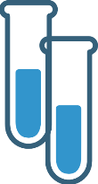
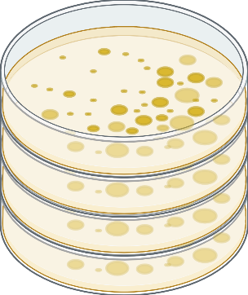
Maltose
4-HB
Fluorescence- and plate- based methods
Extra notes:
We were able to precisely quantify each organism within a liquid coculture via two experimental methods, 1. fluorescence measurements and 2. temperature selective growth. E. coli were labeled with a red fluorescent protein while P. fluorescens were labeled with a green fluorescent protein via a transformed plasmid. By measuring both red and green fluorescence along with optical density we were able to approximate which biomass changes were due to E. coli or P. fluorescens over time.
Fluorescence can be difficult to calibrate due to changes in fluorescent protein expression under different growth conditions or states. To validate our fluorescent reporters we developed a temperature dependent growth assay based on each organism’s inherent physiology. E. coli grows at 37 degrees Celsius whereas P. fluorescens cannot, and P. fluorescens grows at 12 degrees Celsius whereas E. coli cannot. By incubating coculture samples at each temperature we were able to determine the exact ratio and quantity of each organism and validate the accuracy of fluorescence measurements. The green protein signal grows proportionally with P. fluorescens, but red protein signal suddenly increases when E. coli reach their stationary growth phase.
Acetate
E. coli
P. fluorescens
37C˚
12C˚
A two-member community consisting of P. Fluorescens and E. coli was chosen as an experimentally convenient system for several reasons. The genomes of each organism have been extensively studied. We developed two methods to accurately disentangle the composition of a liquid coculture. Finally, our research discovered significant unidirectional cross feeding from E. coli to P. fluorescens that led to interesting competitive dynamics depending on initial carbon source and organism ratio. These qualities led E. coli and P. fluorescens to be an excellent model to showcase our novel community model.

Slide 2
Maltose
4-HB
Acetate
E. coli
P. fluorescens

